Slide 1
CSE 417T Introduction to Machine Learning
Lecture 21
Instructor: Chien-Ju (CJ) Ho

Slide 2
Logistics
Homework 5 is due Dec 2 (Friday)
Exam 2 will be on Dec 8 (Thursday)
Will focus on the topics in the second half of the semester
Note though knowledge is cumulative, so we still assume you know the concepts earlier
Format / logistics will be similar with what we have in Exam 1
Timed exam (75 min) during lecture time in the classroom
Closed-book exam with 2 letter-size cheat sheets allowed (4 pages in total)
No format limitations (it can be typed, written, or a combination)
Dec 6 (Tuesday) will be a review lecture

Slide 3
Recap

Slide 4
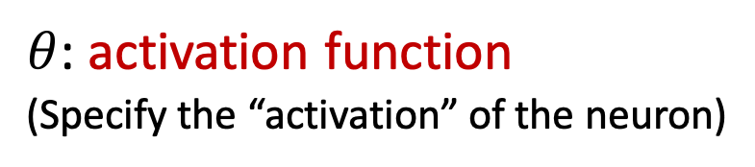
Neural Networks
$θ$: activation function
(Specify the “activation” of the neuron)
We mostly focus on feed-forward network structure

Slide 5
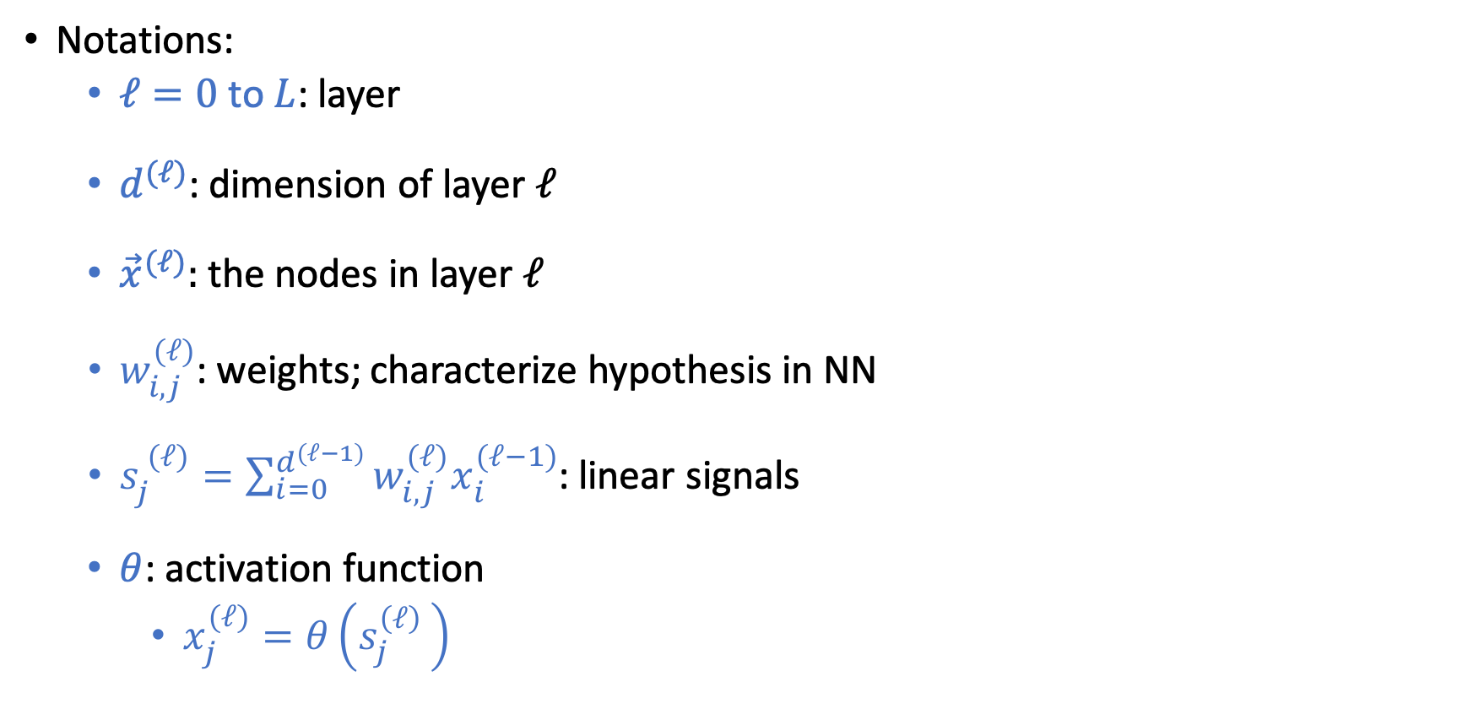
Notations of Neural Networks (NN)
Notations:
$ℓ=0$ to $L$: layer
$d^{(ℓ)}$: dimension of layer $ℓ$
${\vec{x}}^{(ℓ)}:$ the nodes in layer $ℓ$
$w_{i,j}^{(ℓ)}$: weights; characterize hypothesis in NN
$s_{j}^{ (ℓ)}=\sum_{i=0}^{d^{(ℓ−1)}}{w_{i,j}^{(ℓ)}x_{i}^{(ℓ−1)}}$: linear signals
$θ$: activation function
$x_{j}^{(ℓ)}=θ\left(s_{j}^{\left(ℓ\right) }\right)$
Notes:
4x2 + 3x1 = 11

Slide 6

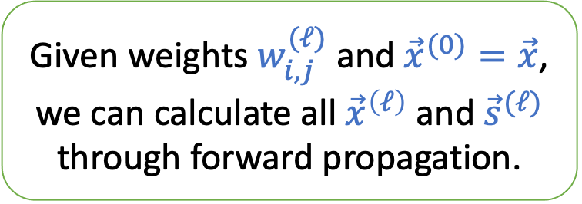
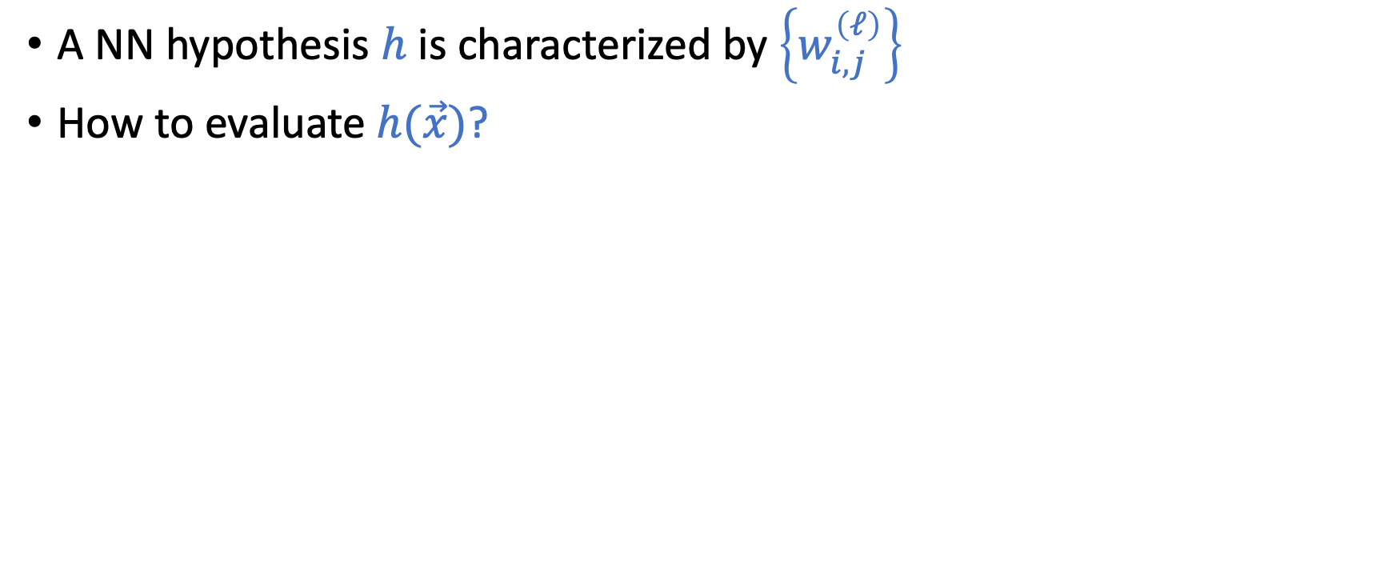
Forward Propagation (evaluate $h(\vec{x})$)
A NN hypothesis $h$ is characterized by $\left\{w_{i,j}^{\left(ℓ\right)}\right\}$
How to evaluate $h(\vec{x})$?
Given weights $w_{i,j}^{(ℓ)}$ and ${\vec{x}}^{(0)}=\vec{x}$, we can calculate all ${\vec{x}}^{\left(ℓ\right)}$ and ${\vec{s}}^{(ℓ)}$ through forward propagation.

Slide 7
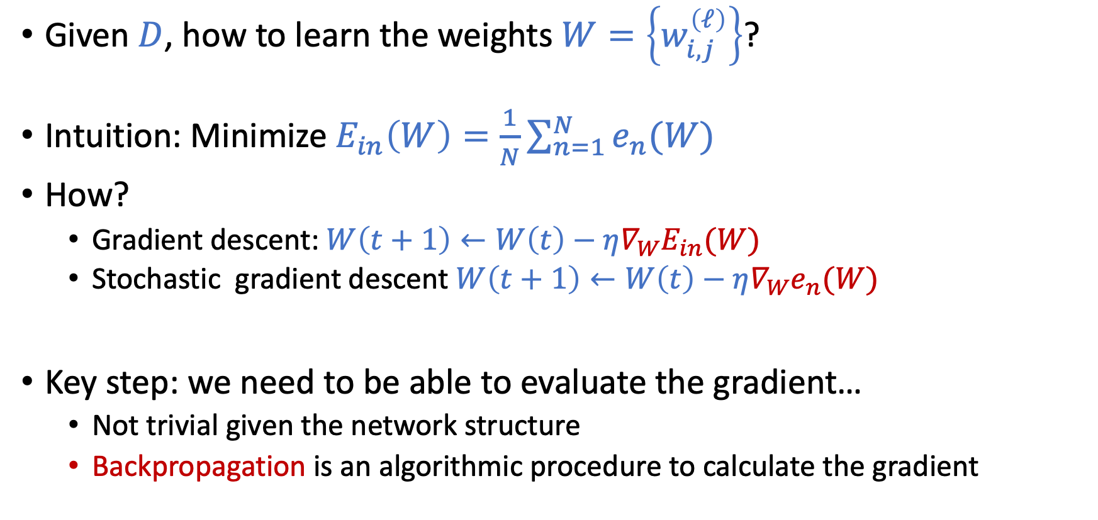
How to Learn NN From Data?
Given $D$, how to learn the weights $W=\left\{w_{i,j}^{\left(ℓ\right)}\right\}$?
Intuition: Minimize $E_{in}\left(W\right)=\frac{1}{N}\sum_{n=1}^{N}{e_{n}(W)}$
How?
Gradient descent: $W\left(t+1\right)←W\left(t\right)−η∇_{W}E_{in}(W)$
Stochastic gradient descent $W\left(t+1\right)←W\left(t\right)−η∇_{W}e_{n}(W)$
Key step: we need to be able to evaluate the gradient…
Not trivial given the network structure
Backpropagation is an algorithmic procedure to calculate the gradient

Slide 8
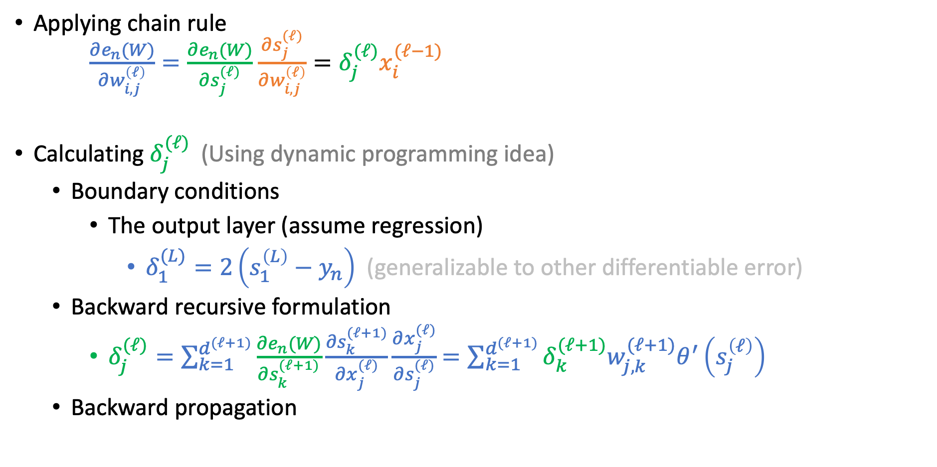

Compute the Gradient $∇_{W}e_{n}(W)$
Applying chain rule $\frac{∂e_{n}(W)}{∂w_{i,j}^{\left(ℓ\right)}}=\frac{∂e_{n}(W)}{∂s_{j}^{(ℓ)}}$ $\frac{∂s_{j}^{(ℓ)}}{∂w_{i,j}^{\left(ℓ\right)}}=δ_{j}^{(ℓ)}x_{i}^{(ℓ−1)}$
Calculating $δ_{j}^{(ℓ)}$ (Using dynamic programming idea)
Boundary conditions
The output layer (assume regression)
$δ_{1}^{(L)}=2\left(s_{1}^{\left(L\right)}−y_{n}\right)$ (generalizable to other differentiable error)
Backward recursive formulation
$δ_{j}^{(ℓ)}=\sum_{k=1}^{d^{(ℓ+1)}}{\frac{∂e_{n}(W)}{∂s_{k}^{(ℓ+1)}}\frac{∂s_{k}^{(ℓ+1)}}{∂x_{j}^{(ℓ)}}\frac{∂x_{j}^{(ℓ)}}{∂s_{j}^{(ℓ)}}}$ $=\sum_{k=1}^{d^{(ℓ+1)}}{δ_{k}^{(ℓ+1)}w_{j,k}^{(ℓ+1)}θ^{′}\left(s_{j}^{\left(ℓ\right)}\right)}$
Backward propagation

Slide 9
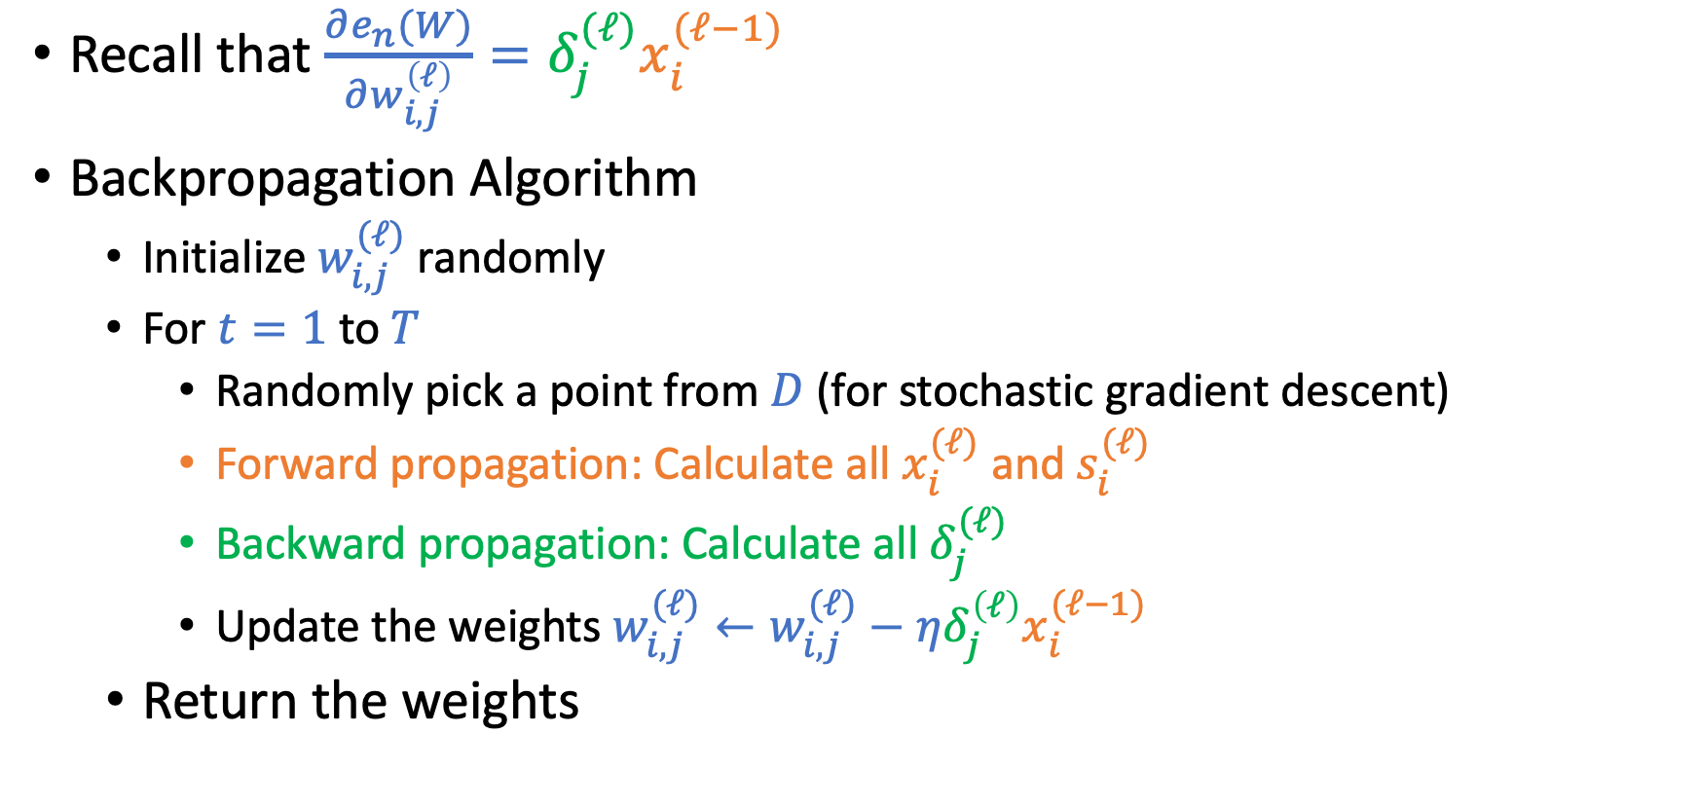
Backpropagation Algorithm
Recall that $\frac{∂e_{n}(W)}{∂w_{i,j}^{\left(ℓ\right)}}=δ_{j}^{(ℓ)}x_{i}^{(ℓ−1)}$
Backpropagation Algorithm
Initialize $w_{i,j}^{(ℓ)}$randomly
For $t=1$ to $T$
Randomly pick a point from $D$ (for stochastic gradient descent)
Forward propagation: Calculate all $x_{i}^{(ℓ)}$ and $s_{i}^{(ℓ)}$
Backward propagation: Calculate all $δ_{j}^{(ℓ)}$
Update the weights $w_{i,j}^{(ℓ)}←w_{i,j}^{(ℓ)}−η{δ_{j}^{\left(ℓ\right)}x}_{i}^{(ℓ−1)}$
Return the weights

Slide 10
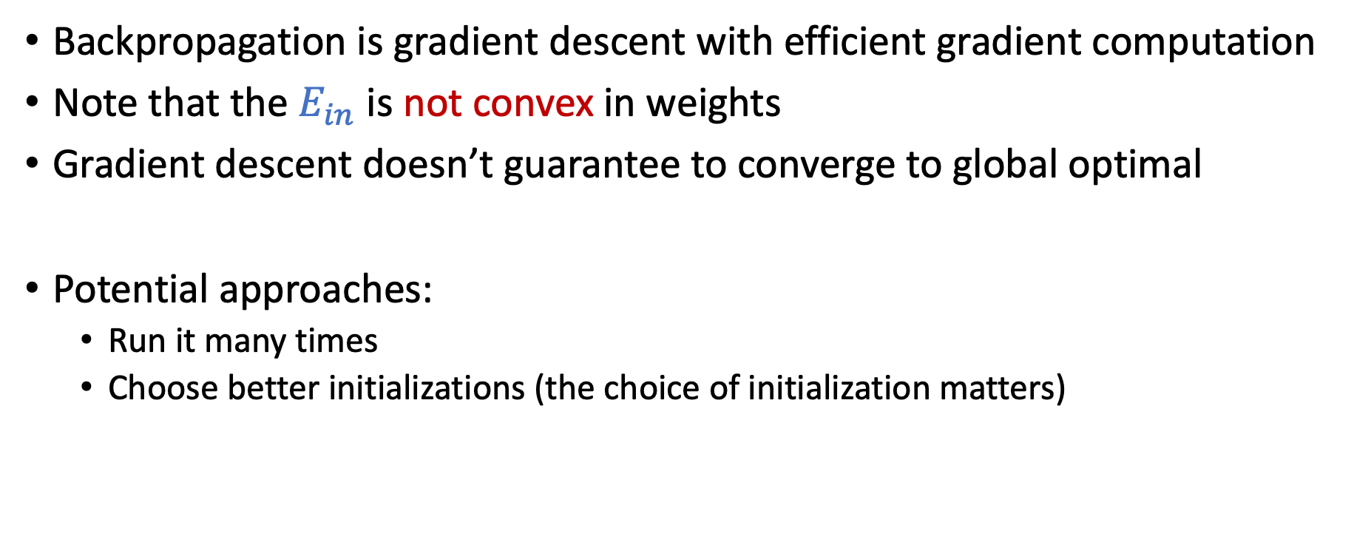
Discussion
Backpropagation is gradient descent with efficient gradient computation
Note that the $E_{in}$ is not convex in weights
Gradient descent doesn’t guarantee to converge to global optimal
Potential approaches:
Run it many times
Choose better initializations (the choice of initialization matters)

Slide 11
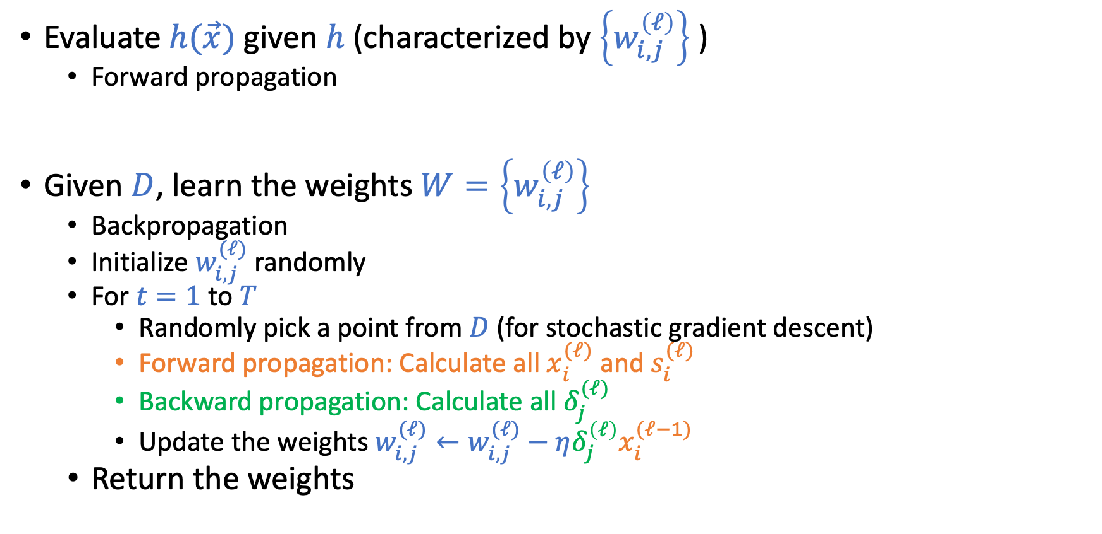
Forward Propagation and Backpropagation
Evaluate $h(\vec{x})$ given $h$ (characterized by $\left\{w_{i,j}^{\left(ℓ\right)}\right\}$ )
Forward propagation
Given $D$, learn the weights $W=\left\{w_{i,j}^{\left(ℓ\right)}\right\}$
Backpropagation
Initialize $w_{i,j}^{(ℓ)}$randomly
For $t=1$ to $T$
Randomly pick a point from $D$ (for stochastic gradient descent)
Forward propagation: Calculate all $x_{i}^{(ℓ)}$ and $s_{i}^{(ℓ)}$
Backward propagation: Calculate all $δ_{j}^{(ℓ)}$
Update the weights $w_{i,j}^{(ℓ)}←w_{i,j}^{(ℓ)}−η{δ_{j}^{\left(ℓ\right)}x}_{i}^{(ℓ−1)}$
Return the weights

Slide 12
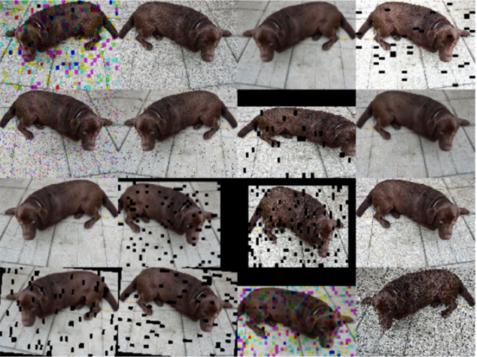

Regularizations in Neural Networks
Weight-based regularization
Early stopping
Dropout
Adding noises (Data augmentation)

Slide 13
Today’s Lecture
The notes are not intended to be comprehensive. They should be accompanied by lectures and/or textbook.
Let me know if you spot errors.
Notes:
This is the lecture I wish I have 6 chalkboards to utilize

Slide 14
Deep Learning

Slide 15
Brief/Informal History

Slide 16
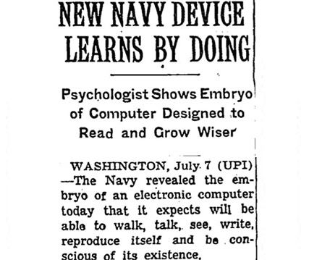
New York Times
Image source: https://beamandrew.github.io/deeplearning/2017/02/23/deep_learning_101_part1.html

Slide 17
Minsky: “However, I started to worry about what such a machine could not do. For example, it could tell ‘E’s from ‘F’s, and ‘5’s from ‘6’s—things like that. But when there were disturbing stimuli near these figures that weren’t correlated with them the recognition was destroyed.”
Image source: https://beamandrew.github.io/deeplearning/2017/02/23/deep_learning_101_part1.html

Slide 18
Image source: https://beamandrew.github.io/deeplearning/2017/02/23/deep_learning_101_part1.html

Slide 19
Image source: https://beamandrew.github.io/deeplearning/2017/02/23/deep_learning_101_part1.html

Slide 20
Image source: https://beamandrew.github.io/deeplearning/2017/02/23/deep_learning_101_part1.html

Slide 21
ImageNet Challenge 2012

Slide 23
What is “Deep” Learning
Neural networks with many layers

Slide 24
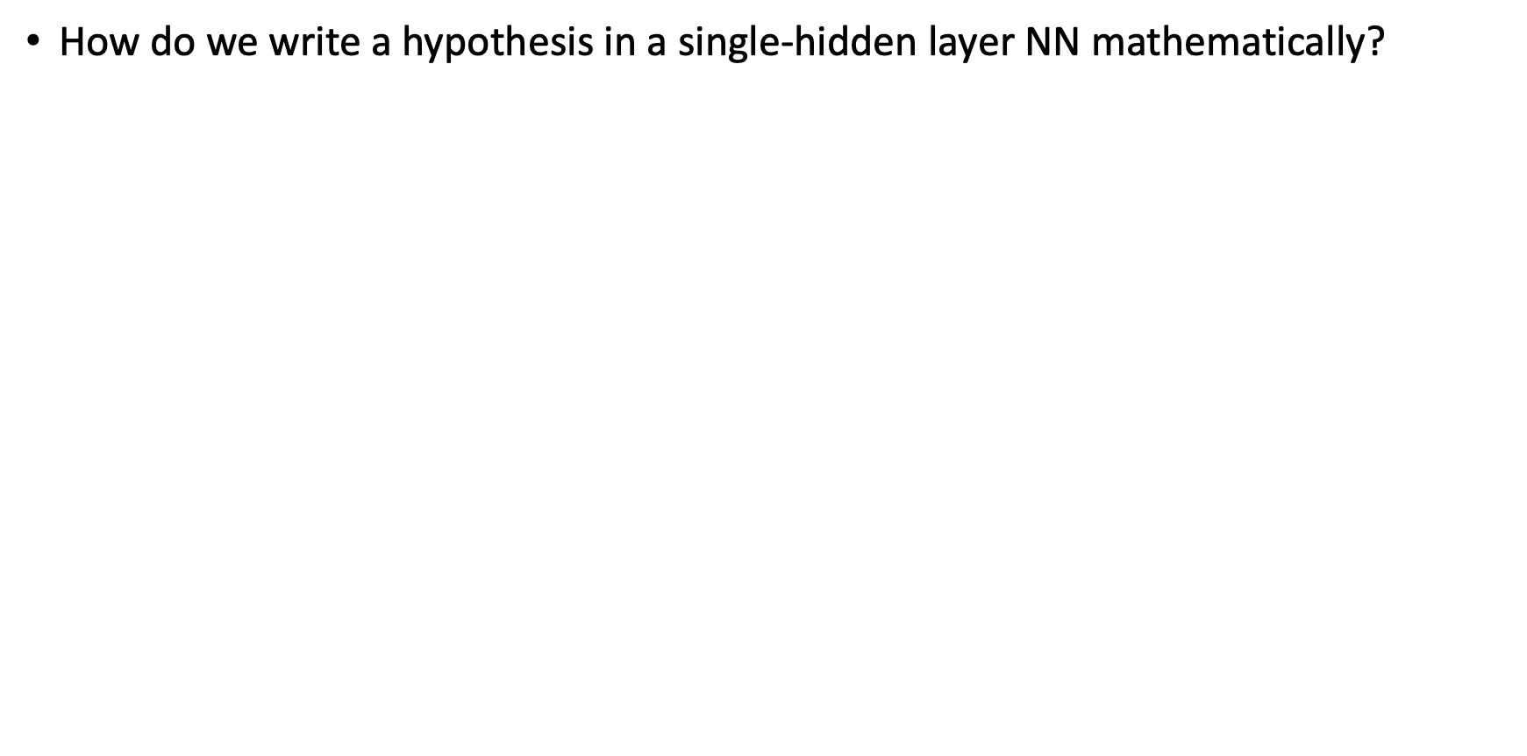
Single Hidden-Layer Neural Network
How do we write a hypothesis in a single-hidden layer NN mathematically?
$h\left(\vec{x}\right)=θ\left(w_{0,1}^{\left(2\right)}+\sum_{j=1}^{d^{\left(1\right)}}{w_{j,1}^{\left(2\right)}x_{j}^{\left(1\right)}}\right)$
$h\left(\vec{x}\right)=θ\left(w_{0,1}^{\left(2\right)}+\sum_{j=1}^{d^{\left(1\right)}}{w_{j,1}^{\left(2\right)}θ(\sum_{i=0}^{d^{(0)}}{w_{i,j}^{(1)}x_{i}})}\right)$
How do we write a linear model with nonlinear transform
$h(\vec{x})=θ\left(w_{0}+\sum{w_{i}φ_{i}(\vec{x})}\right)$
How do we write a Kernel SVM hypothesis
$g(\vec{x})=θ\left(b^{∗}+\sum_{α_{n}^{∗}>0}{α_{n}^{∗}y_{n}K({\vec{x}}_{n},\vec{x})}\right)$
Interpretation:
The hidden layer is like feature transform
Shallow learning vs. deep learning

Slide 25
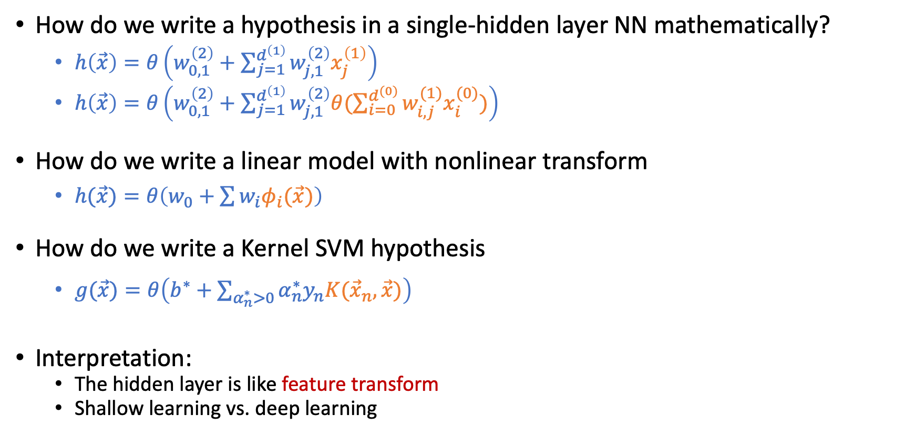
Single Hidden-Layer Neural Network
How do we write a hypothesis in a single-hidden layer NN mathematically?
$h\left(\vec{x}\right)=θ\left(w_{0,1}^{\left(2\right)}+\sum_{j=1}^{d^{\left(1\right)}}{w_{j,1}^{\left(2\right)}x_{j}^{\left(1\right)}}\right)$
$h\left(\vec{x}\right)=θ\left(w_{0,1}^{\left(2\right)}+\sum_{j=1}^{d^{\left(1\right)}}{w_{j,1}^{\left(2\right)}θ(\sum_{i=0}^{d^{(0)}}{w_{i,j}^{(1)}x_{i}^{(0)}})}\right)$
How do we write a linear model with nonlinear transform
$h(\vec{x})=θ\left(w_{0}+\sum{w_{i}φ_{i}(\vec{x})}\right)$
How do we write a Kernel SVM hypothesis
$g(\vec{x})=θ\left(b^{∗}+\sum_{α_{n}^{∗}>0}{α_{n}^{∗}y_{n}K({\vec{x}}_{n},\vec{x})}\right)$
Interpretation:
The hidden layer is like feature transform
Shallow learning vs. deep learning

Slide 26
Deep Neural Network
“Shallow” neural network is powerful (universal approximation theorem holds with a single hidden layer). Why “deep” neural networks?
Each layer captures features
of the previous layers.
We can use “raw data” (e.g., pixels of an image) as input. The hidden layer are extracting the features.
Design different network architectures to incorporate domain knowledge.

Slide 27


Convolutional Neural Networks (CNN)
Captures the localized properties of features hierarchically

Slide 28

Convolutional Filters
A convolutional filter is like a matrix version of a dot product.
0 | 0 | 0 | 0 | 0 | 0
0 | 1 | 2 | 2 | 1 | 0
0 | 2 | 4 | 4 | 2 | 0
0 | 1 | 3 | 3 | 1 | 0
0 | 1 | 2 | 3 | 1 | 0
0 | 0 | 1 | 1 | 0 | 0
0 | 1 | 0
1 | -4 | 1
0 | 1 | 0
$$∗$$

Slide 29

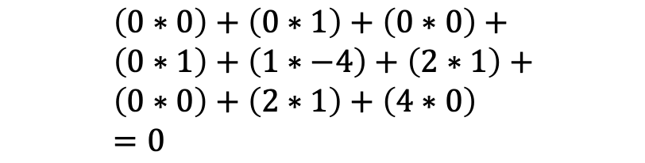
Convolutional Filters
A convolutional filter is like a matrix version of a dot product.
0 | 0 | 0 | 0 | 0 | 0
0 | 1 | 2 | 2 | 1 | 0
0 | 2 | 4 | 4 | 2 | 0
0 | 1 | 3 | 3 | 1 | 0
0 | 1 | 2 | 3 | 1 | 0
0 | 0 | 1 | 1 | 0 | 0
0
0 | 1 | 0
1 | -4 | 1
0 | 1 | 0
$$∗$$
$$=$$
$$\left(0∗0\right)+\left(0∗1\right)+\left(0∗0\right)+ \\ \left(0∗1\right)+\left(1∗−4\right)+\left(2∗1\right)+ \\ \left(0∗0\right)+\left(2∗1\right)+\left(4∗0\right) \\ =0$$

Slide 30
Convolutional Filters
A convolutional filter is like a matrix version of a dot product.
0 | 0 | 0 | 0 | 0 | 0
0 | 1 | 2 | 2 | 1 | 0
0 | 2 | 4 | 4 | 2 | 0
0 | 1 | 3 | 3 | 1 | 0
0 | 1 | 2 | 3 | 1 | 0
0 | 0 | 1 | 1 | 0 | 0
0
0 | 1 | 0
1 | -4 | 1
0 | 1 | 0
$$∗$$
$$=$$

Slide 31
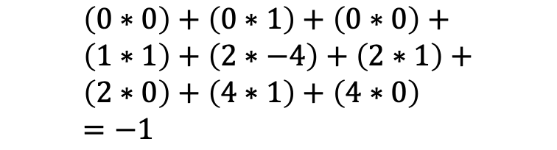
Convolutional Filters
A convolutional filter is like a matrix version of a dot product.
0 | 0 | 0 | 0 | 0 | 0
0 | 1 | 2 | 2 | 1 | 0
0 | 2 | 4 | 4 | 2 | 0
0 | 1 | 3 | 3 | 1 | 0
0 | 1 | 2 | 3 | 1 | 0
0 | 0 | 1 | 1 | 0 | 0
0 | -1
0 | 1 | 0
1 | -4 | 1
0 | 1 | 0
$$∗$$
$$=$$
$$\left(0∗0\right)+\left(0∗1\right)+\left(0∗0\right)+ \\ \left(1∗1\right)+\left(2∗−4\right)+\left(2∗1\right)+ \\ \left(2∗0\right)+\left(4∗1\right)+\left(4∗0\right) \\ =−1$$

Slide 32
Convolutional Filters
A convolutional filter is like a matrix version of a dot product.
0 | 0 | 0 | 0 | 0 | 0
0 | 1 | 2 | 2 | 1 | 0
0 | 2 | 4 | 4 | 2 | 0
0 | 1 | 3 | 3 | 1 | 0
0 | 1 | 2 | 3 | 1 | 0
0 | 0 | 1 | 1 | 0 | 0
0 | -1 | -1 | 0
-2 | -5 | -5 | -2
2 | -2 | -1 | 3
-1 | 0 | -5 | 0
0 | 1 | 0
1 | -4 | 1
0 | 1 | 0
$$∗$$
$$=$$

Slide 33
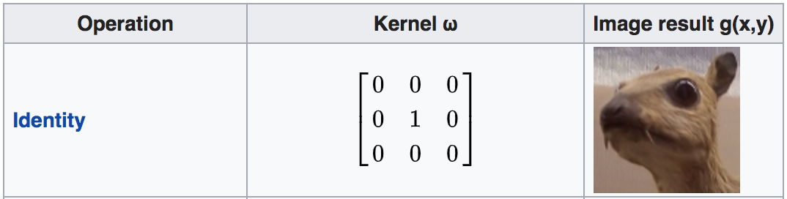


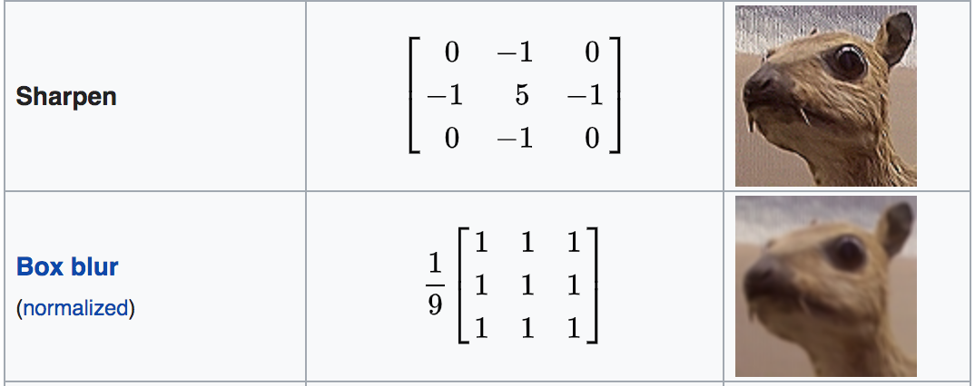
Convolutional Filters
https://en.wikipedia.org/wiki/Kernel_(image_processing)

Slide 34
Convolutional Filters
https://en.wikipedia.org/wiki/Kernel_(image_processing)

Slide 35
Convolutional Filters
https://en.wikipedia.org/wiki/Kernel_(image_processing)

Slide 36
Convolutional Filters
https://en.wikipedia.org/wiki/Kernel_(image_processing)

Slide 37
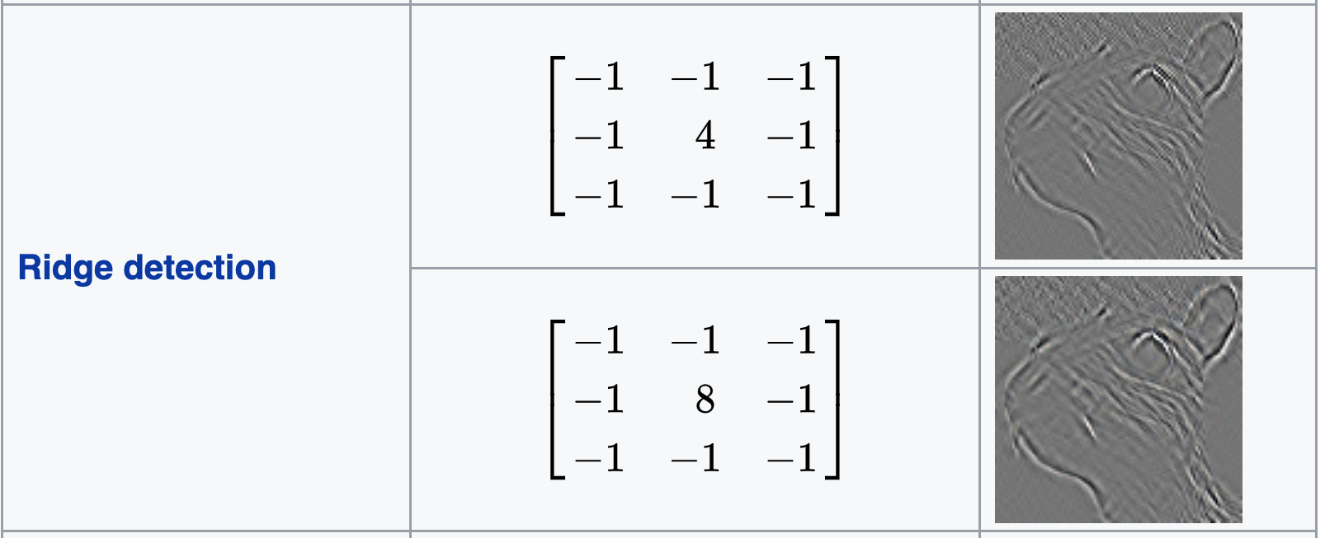
Convolutional Filters
https://en.wikipedia.org/wiki/Kernel_(image_processing)

Slide 38
Convolutional Filters
https://en.wikipedia.org/wiki/Kernel_(image_processing)

Slide 39
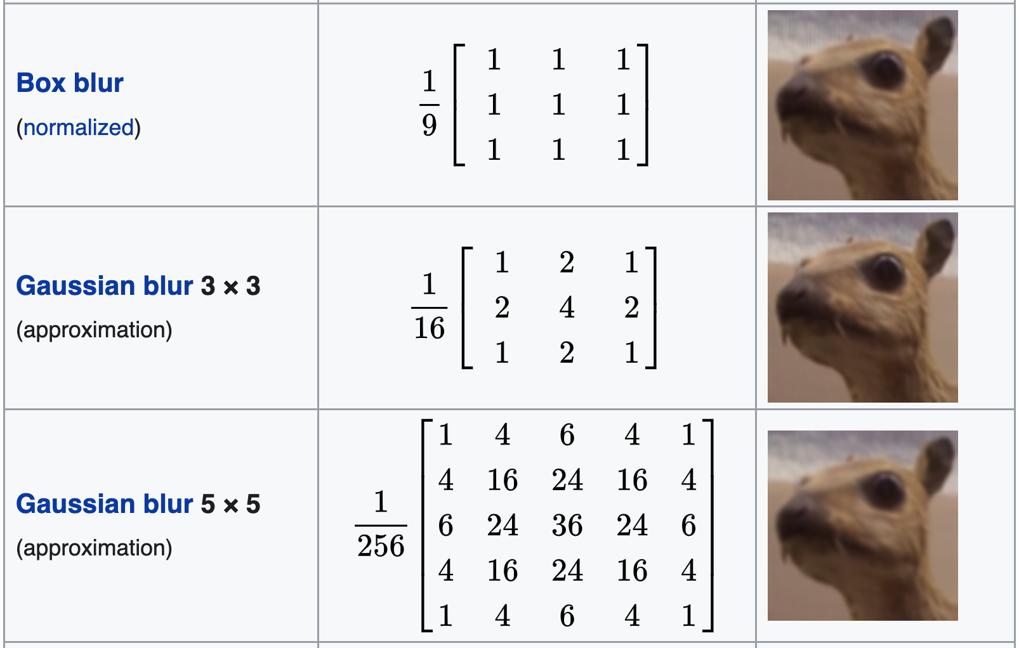
Convolutional Filters
https://en.wikipedia.org/wiki/Kernel_(image_processing)

Slide 40


Connection to Neural Networks
Convolutions can be represented by a network structure
Nodes in the previous layer are only connected to “adjacent” nodes in the next layer.
Many of the weights have the same value.
0 | 0 | 0 | 0 | 0 | 0
0 | 1 | 2 | 2 | 1 | 0
0 | 2 | 4 | 4 | 2 | 0
0 | 1 | 3 | 3 | 1 | 0
0 | 1 | 2 | 3 | 1 | 0
0 | 0 | 1 | 1 | 0 | 0
0 | -1 | -1 | 0
-2 | -5 | -5 | -2
2 | -2 | -1 | 3
-1 | 0 | -5 | 0
0 | 1 | 0
1 | -4 | 1
0 | 1 | 0
$$∗$$
$$=$$

Slide 41
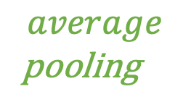
Pooling Layers
Commonly used in convolutional neural networks. A subsampling / down-sampling process:
Combines multiple adjacent nodes into a single node
Reduce the dimensionality of input. More robust to noise.
0 | -1 | -1 | 0
-2 | -5 | -5 | -2
2 | -2 | 2 | 3
-1 | 1 | -5 | 0
-2 | -2
0 | 0
$$average$$
pooling

Slide 42
Convolutional Neural Networks (CNN)
Captures the localized properties of features
Particularly suitable for computer vision (images)
Go (AlphaGo) is another famous application of CNN

Slide 43
Another Example Network Structure [Safe to Skip for the Exam]
Recurrent Neural Network (RNN)
Aim to deal with time-series data, such as natural language processing
Using hidden layers to store temporal information
Allow previous outputs to be used as inputs and keep hidden states
[Images from Wikipedia]

Slide 44
Some Techniques in Improving Deep Learning
Regularization to mitigate overfitting
Weight-based, early stopping, dropout, etc
Incorporating domain knowledges
Network architectures (e.g., Convolutional Neural Nets)
Improving computation with huge amount of data
Hardware architecture to improve parallel computation
Improving gradient-based optimization
Choosing better initialization points

Slide 45
Initialization
Why initialization matters in deep learning
Error is nonconvex in NN
Vanishing/exploding gradient problem

Slide 46

Error is Nonconvex in Neural Networks
We mostly adopt gradient-descent-style algorithms for optimization.
No guarantee to converge to global optimal.
Need to run it many times.
Initialization matters.

Slide 47
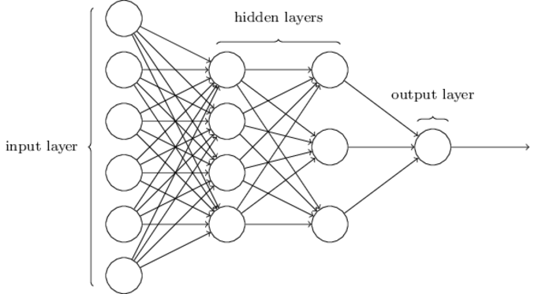
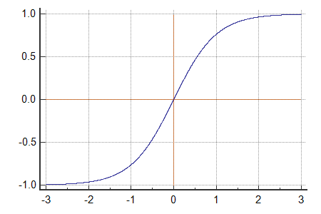
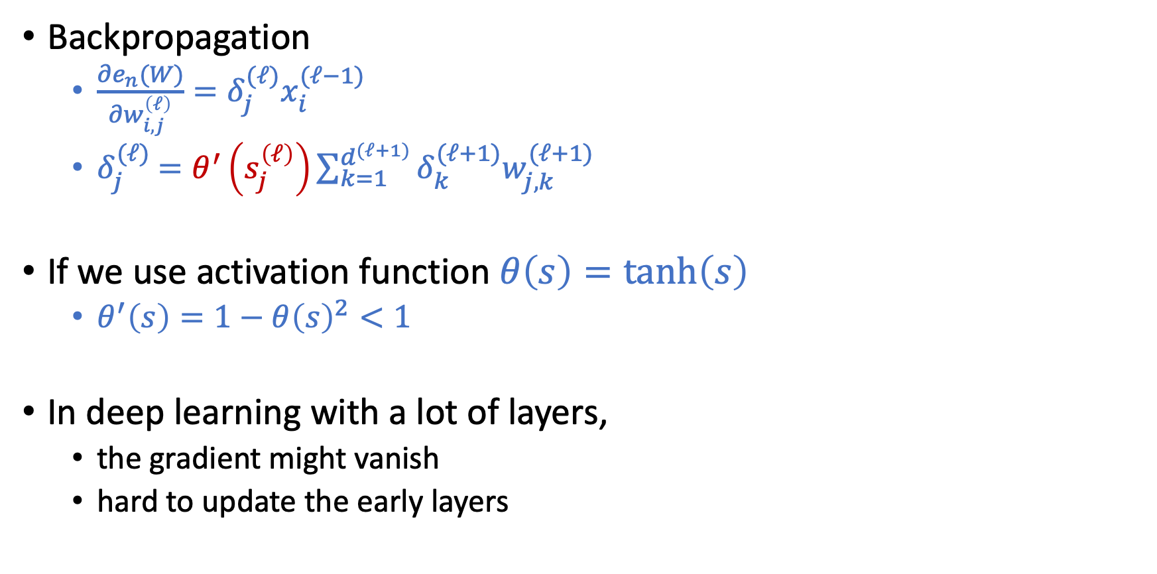
Vanishing Gradient Problem
Backpropagation
$\frac{∂e_{n}(W)}{∂w_{i,j}^{\left(ℓ\right)}}=δ_{j}^{(ℓ)}x_{i}^{(ℓ−1)}$
$δ_{j}^{(ℓ)}$ $=θ^{′}\left(s_{j}^{\left(ℓ\right)}\right)\sum_{k=1}^{d^{(ℓ+1)}}{δ_{k}^{(ℓ+1)}w_{j,k}^{(ℓ+1)}}$
If we use activation function $θ\left(s\right)=\tanh\left(s\right)$
$θ^{′}\left(s\right)=1−θ{\left(s\right)}^{2}<1$
In deep learning with a lot of layers,
the gradient might vanish
hard to update the early layers

Slide 48
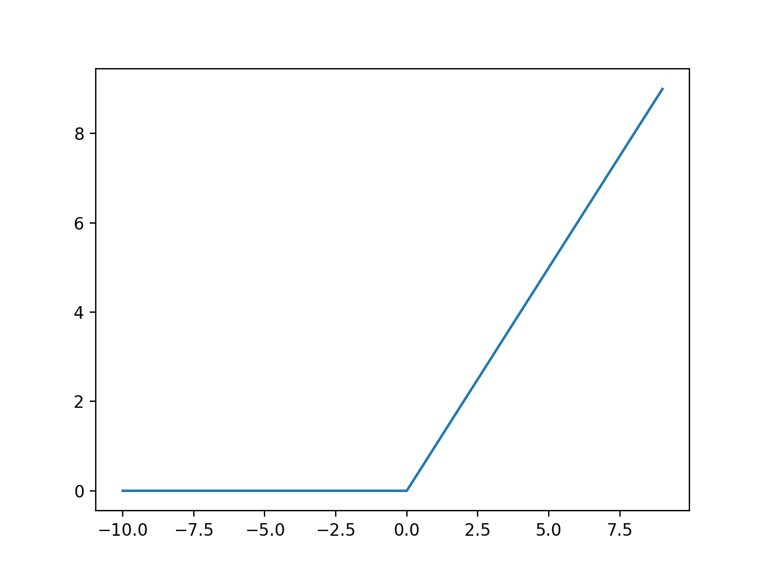
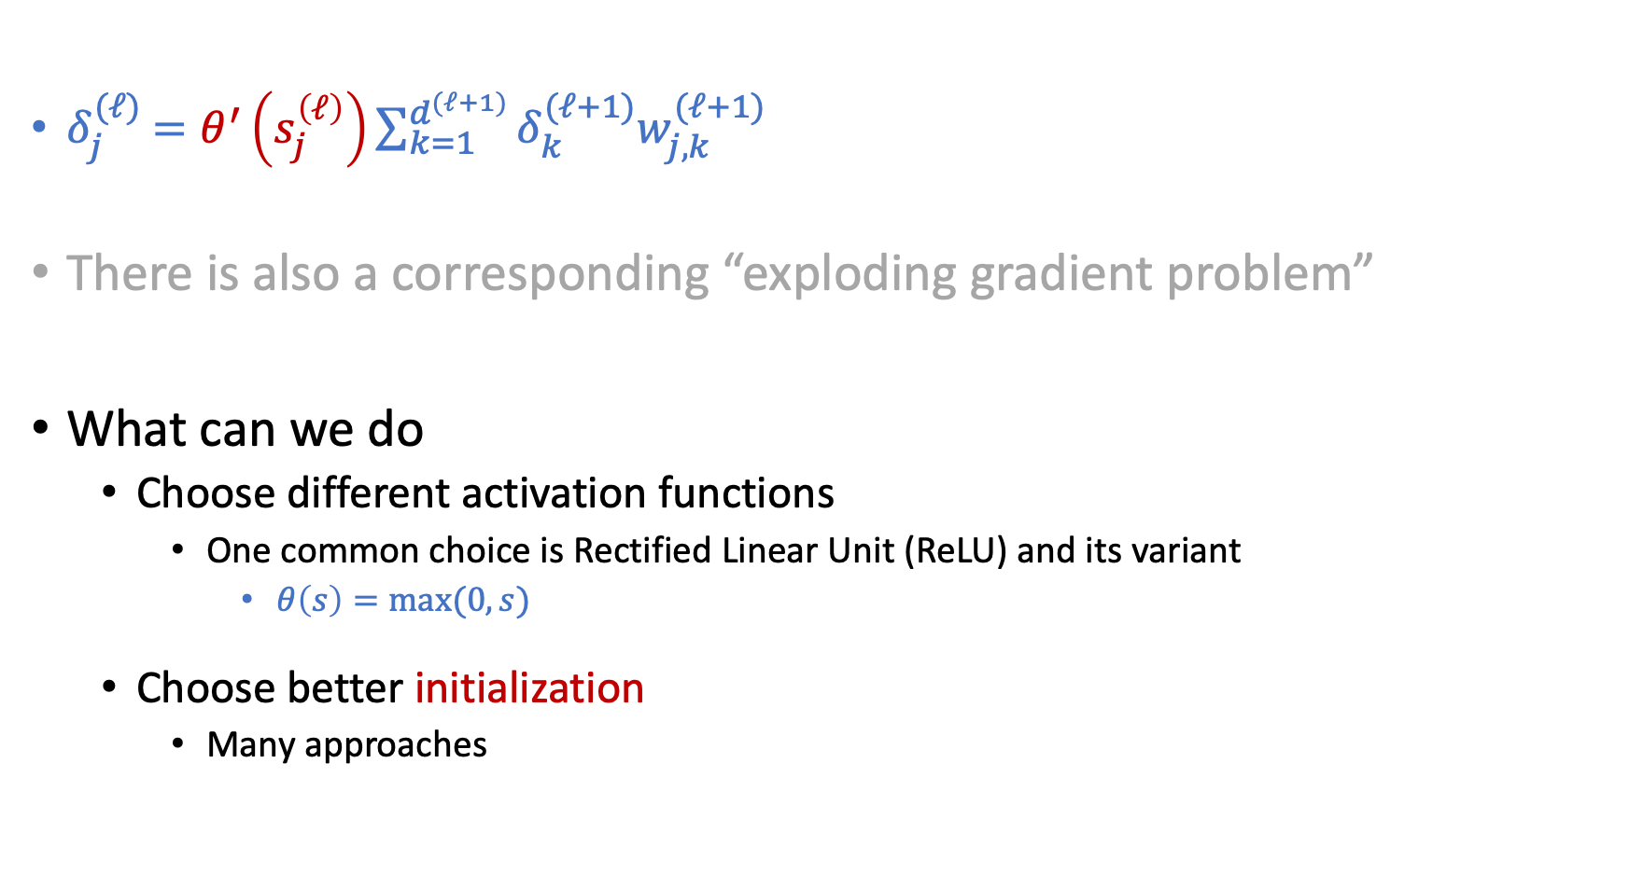
Vanishing Gradient Problem
$δ_{j}^{(ℓ)}$ $=θ^{′}\left(s_{j}^{\left(ℓ\right)}\right)\sum_{k=1}^{d^{(ℓ+1)}}{δ_{k}^{(ℓ+1)}w_{j,k}^{(ℓ+1)}}$
There is also a corresponding “exploding gradient problem”
What can we do
Choose different activation functions
One common choice is Rectified Linear Unit (ReLU) and its variant
$θ\left(s\right)=max⁡(0,s)$
Choose better initialization
Many approaches

Slide 49
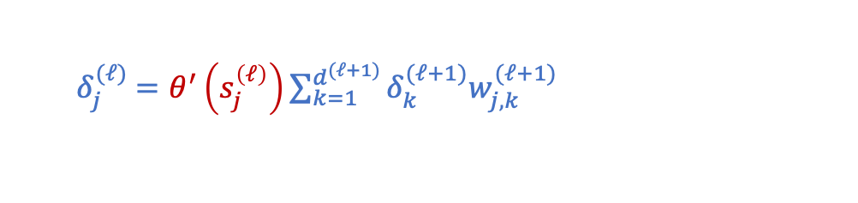
Weight Initialization
Initializing weights to all 0 is a bad idea
Q6b of HW1
Hint: Look at the backpropagation formulation
Randomly Initializing weights to regions so that vanishing/exploding gradients are less likely to happen
Activation-function dependent
e.g., Xavier initialization for tanh
Learning the initialization that might be closer to the optimal
E.g., using autoencoder
$δ_{j}^{(ℓ)}$ $=θ^{′}\left(s_{j}^{\left(ℓ\right)}\right)\sum_{k=1}^{d^{(ℓ+1)}}{δ_{k}^{(ℓ+1)}w_{j,k}^{(ℓ+1)}}$

Slide 50
Initialization
Hard to initialize the entire network well.
Intuition: Initialize the weights layer by layer such that each layer preserves the properties of the previous layer.

Slide 51


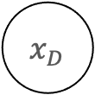
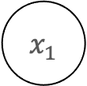



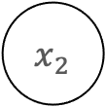
Autoencoders
$$1$$
$$1$$
$$1$$
$$x_{1}$$
$$θ$$
……
$$x_{2}$$
$$θ$$
$$⋮$$
$$x_{D}$$
The hidden layer can be considered as a feature transform. Can we ensure this transformation contain as much information about the original input as possible?

Slide 52
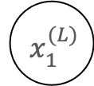

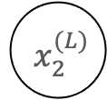
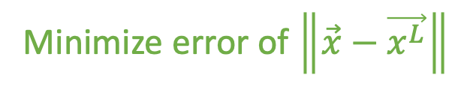
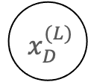
Autoencoders
$$1$$
$$1$$
$$1$$
$$x_{1}$$
$${ x}_{1}^{(L)}$$
$$θ$$
$$x_{2}$$
$${ x}_{2}^{(L)}$$
$$θ$$
$$⋮$$
$$⋮$$
$$x_{D}$$
$${ x}_{D}^{(L)}$$
Minimize error of $\left\|\vec{x}−\vec{x^{L}}\right\|$

Slide 53
Autoencoders
$$1$$
$$1$$
$$1$$
$$x_{1}$$
$${ x}_{1}^{(L)}$$
$$θ$$
$$x_{2}$$
$${ x}_{2}^{(L)}$$
$$θ$$
$$⋮$$
$$⋮$$
$$x_{D}$$
$${ x}_{D}^{(L)}$$
Encoder
Decoder

Slide 54
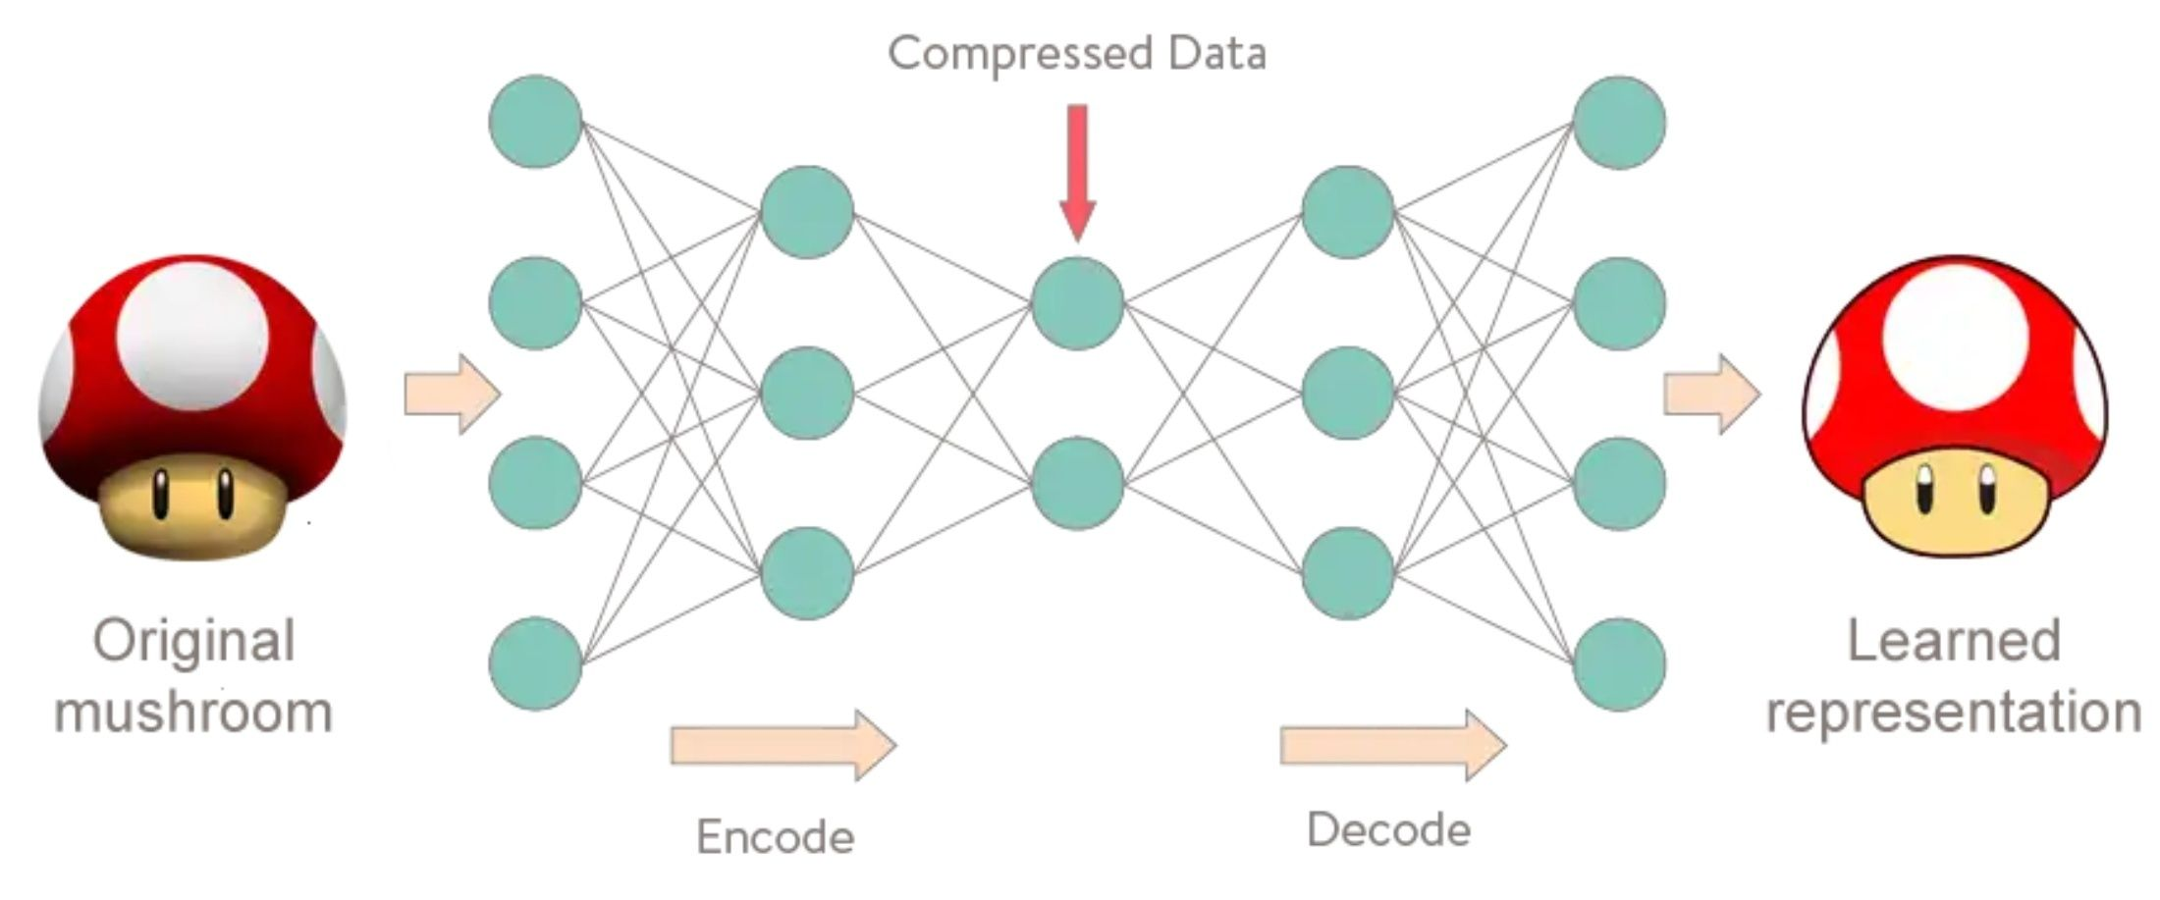
Autoencoder
Unsupervised learning!
https://www.meetup.com/Le-Mans-School-of-AI/photos/29159837/477498782/

Slide 55
Cool Stuffs for Deep Learning
[Safe to Skip for the exam]

Slide 56
Generative Adversarial Nets (GAN)
A Competition: Generator vs Discriminator
Discriminator wants to correctly classify the images (true images or not)
Generator wants to generate images that discriminator can’t classify
[Safe to Skip for the Exam]

Slide 57
https://thisPersonDoesNotExist.com/

Slide 58
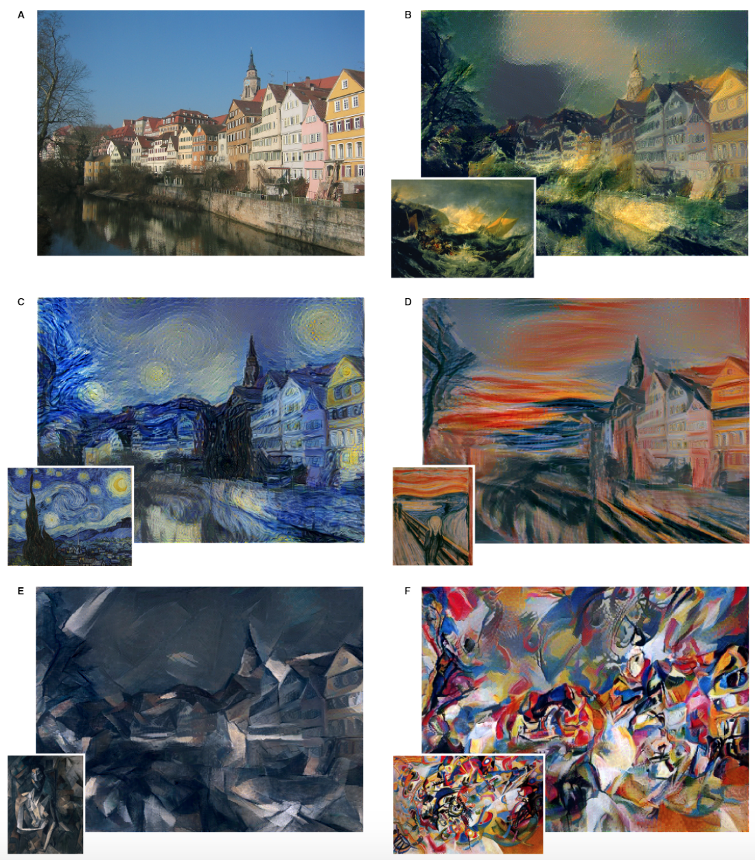
Style Transfer
Informal intuitions:
Recall that we can treat hidden layers as feature transforms
Deep learning is learning representation of data
How to achieve style transfer:
Learn a content representation for an image using hidden layers
Learn a style representation for an image using hidden layers
Compute an image that jointly minimizes the distance from the content image’s content representation and the style image’s style representation
https://arxiv.org/pdf/1508.06576.pdf
[Safe to Skip for the Exam]

Slide 59
Machine Learning Life Cycle

Slide 60
Machine Learning Lifecycle
Feedback
Task Definition
Deployment
Dataset Construction
Testing
Model Definition
Training

Slide 61
Machine Learning Lifecycle
Feedback
Task Definition
Deployment
Dataset Construction
What we covered
(and majority of ML research)
Testing
Model Definition
Training

Slide 62
Machine Learning Lifecycle
To have “positive” impacts, we need to be careful in every stage
Feedback
Task Definition
Deployment
Dataset Construction
What we covered
(and majority of ML research)
Testing
Model Definition
Training

Slide 63
Strategic Classification
Or more recently, people start to call it “performative prediction”

Slide 64
Supervised Learning
Standard setup of (supervised) machine learning
Finding patterns from the given training datasets
Use the pattern to make predictions on new testing data
Fundamental assumption:
Training and testing data points are i.i.d. drawn from the same distribution

Slide 65
Social Program Eligibility [Camacho and Conover, 2012]
Notes:
Social welfare program in Columbia

Slide 66
A More ML Example: Spam Filter

Slide 67
A More ML Example: Spam Filter

Slide 68
A More ML Example: Spam Filter

Slide 69
Goodhart’s law:
“If a measure becomes the public’s goal, it is no longer a good measure.”

Slide 70



Slide 71
Strategic Classification

Slide 72
Machine Learning Lifecycle
Feedback
Task Definition
Deployment
Dataset Construction
Testing
Model Definition
Training

Slide 73
A Quick Flashback to RBF

Slide 74
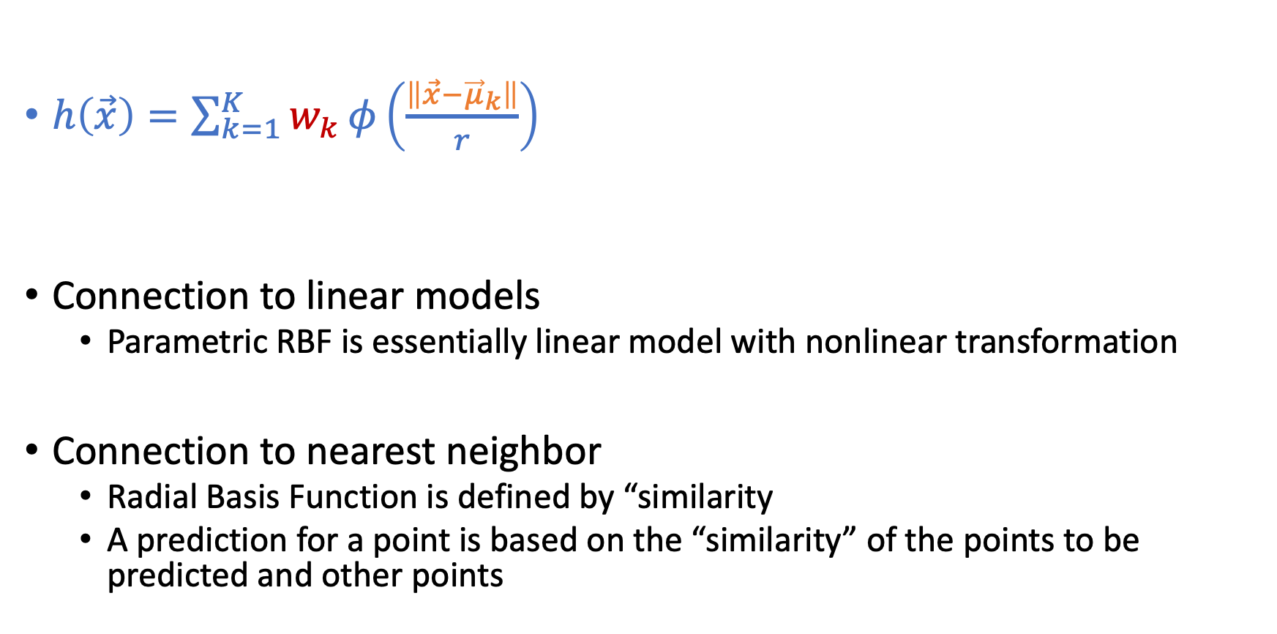
RBF Function
$h\left(\vec{x}\right)=\sum_{k=1}^{K}{w_{k}}φ\left(\frac{\left\|\vec{x}−{\vec{μ}}_{k}\right\|}{r}\right)$
Connection to linear models
Parametric RBF is essentially linear model with nonlinear transformation
Connection to nearest neighbor
Radial Basis Function is defined by “similarity
A prediction for a point is based on the “similarity” of the points to be predicted and other points

Slide 75
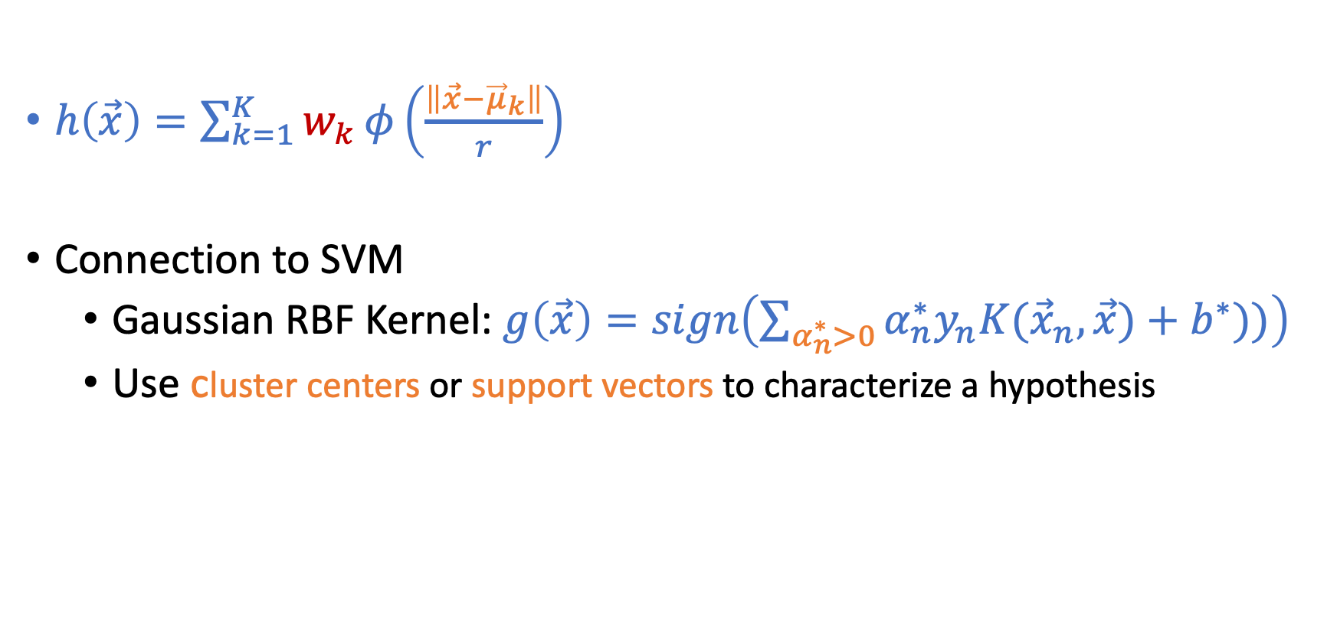
More Discussion on RBF
$h\left(\vec{x}\right)=\sum_{k=1}^{K}{w_{k}}φ\left(\frac{\left\|\vec{x}−{\vec{μ}}_{k}\right\|}{r}\right)$
Connection to SVM
Gaussian RBF Kernel: $g\left(\vec{x}\right)=sign\left(\sum_{α_{n}^{∗}>0}{α_{n}^{∗}y_{n}K({\vec{x}}_{n},\vec{x})}+b^{∗}))\right)$
Use cluster centers or support vectors to characterize a hypothesis
SVM
RBF

Slide 76
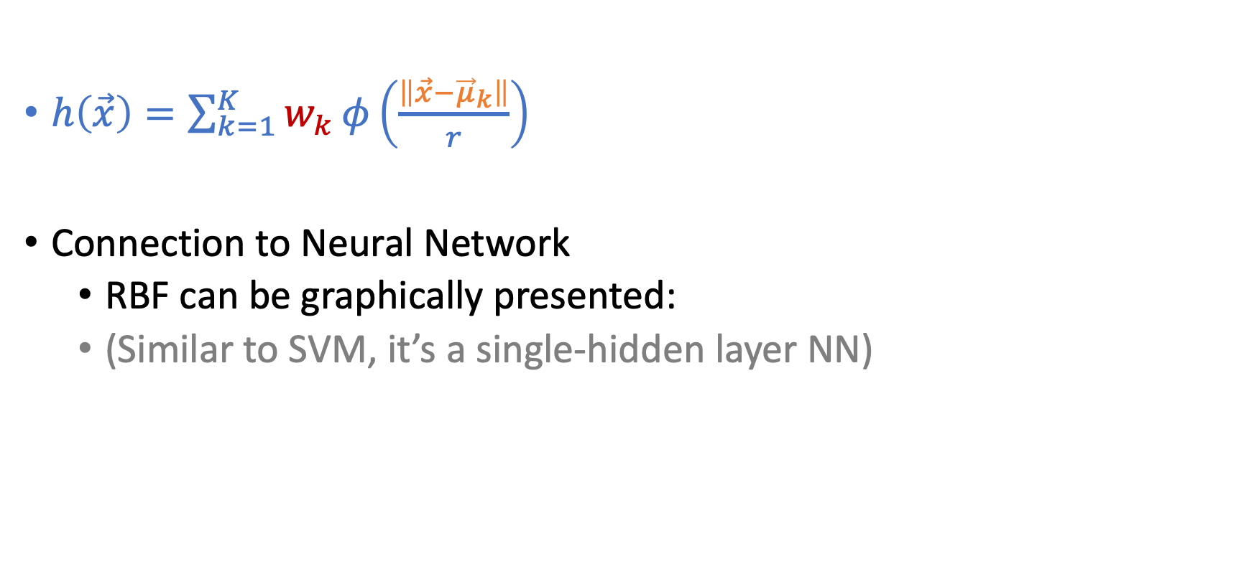
More Discussion on RBF
$h\left(\vec{x}\right)=\sum_{k=1}^{K}{w_{k}}φ\left(\frac{\left\|\vec{x}−{\vec{μ}}_{k}\right\|}{r}\right)$
Connection to Neural Network
RBF can be graphically presented:
(Similar to SVM, it’s a single-hidden layer NN)

